Slide 1

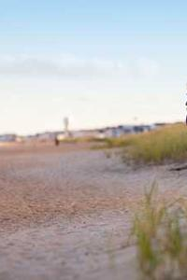
Images and Measurement In Pixels
200 px
Unit Of Measurement (pixels - px)
Images are measured in pixels, with each pixel representing a tiny dot. More pixels result in higher resolution and clearer images. Written as 200 x 300 (W x H)
300 px
Aspect Ratio Of Images
Aspect ratio is the ratio of an image's width to its height, ensuring proportional resizing without distortion.
For image of size 200px x 300px the aspect ratio is 2:3

